Slide 1
Covid-19 Diagnosis on COVIDx CXR-3 Dataset through Lung Segmentation
Presenter: DAO THI TRUC LOAN
JULY 26, 2022

Slide 2

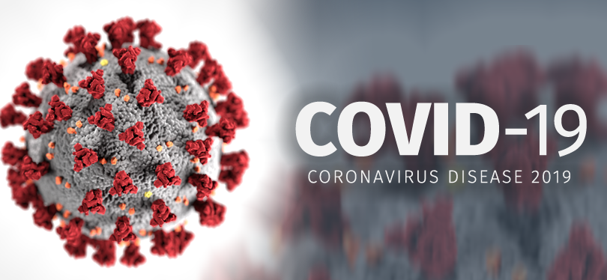
Background
Covid-19
<number>

Slide 3
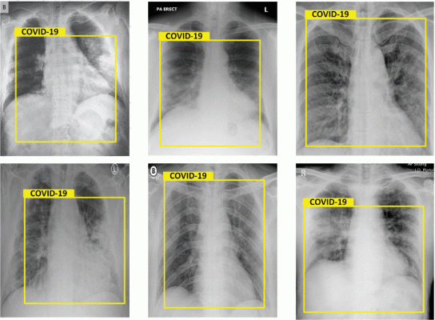
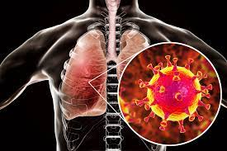
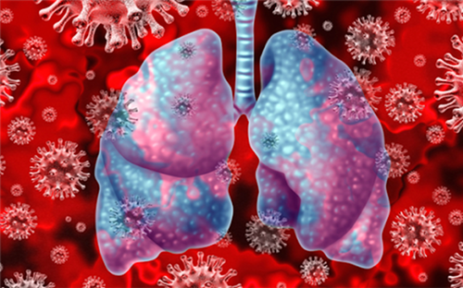
Background
Covid-19 → Lung → Chest X-ray
Results of chest X-Rays, detected as Covid-19. Images courtesy of IEEE
<number>

Slide 4
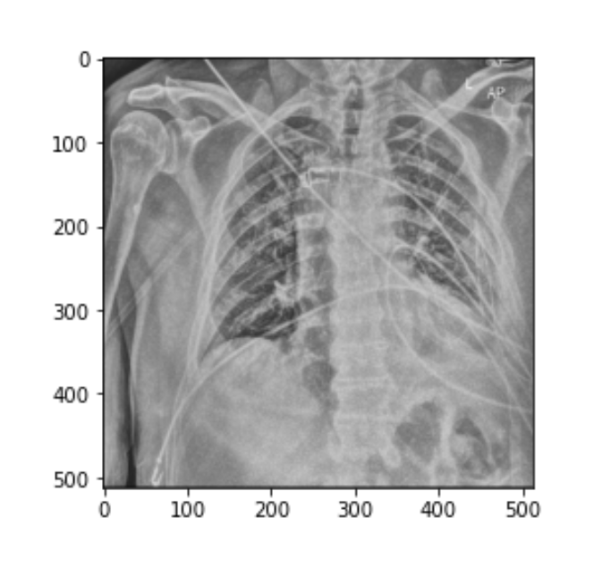
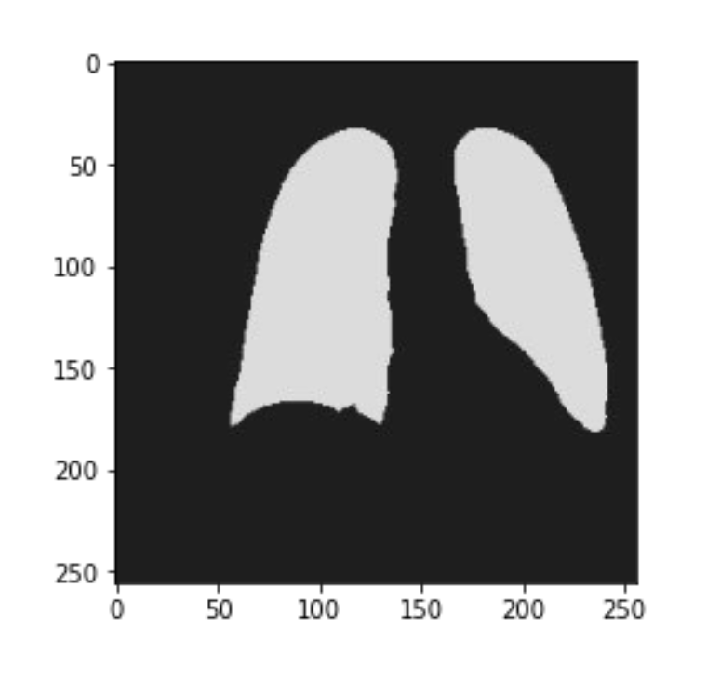
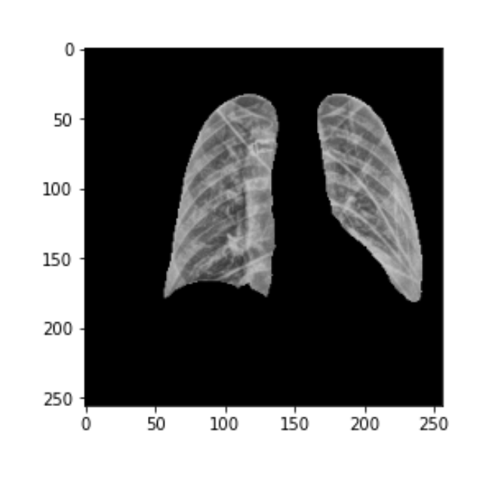
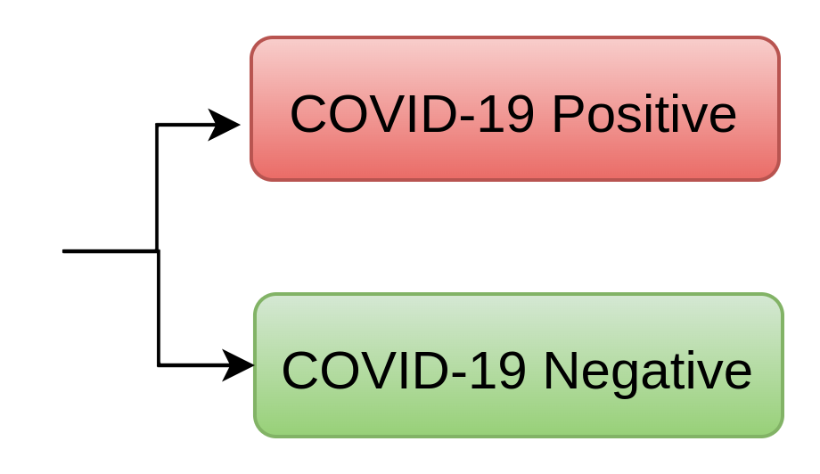
Background
Covid-19 → Lung → Chest X-ray → segmentation → classification
+
=
Chest X-ray
Lung segment
<number>

Slide 5
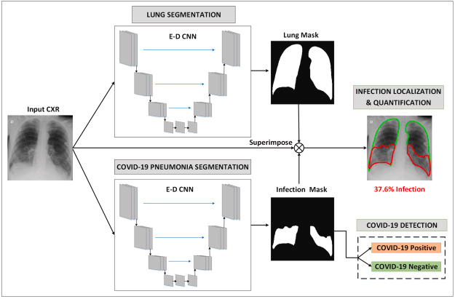
Related works
(1) A.M. Tahir et al., COVID-19 infection localization and severity grading from chestX-ray images, Computers in Biology and Medicine 139 (2021) 105002
<number>

Slide 6
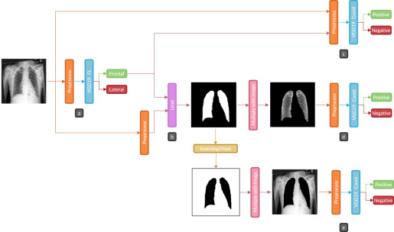
Related works
(2) Arias-Garzón, Daniel, et al. "COVID-19 detection in X-ray images using convolutional neural networks." Machine Learning with Applications 6 (2021): 100138.
<number>

Slide 7
Datasets
TRAIN LUNG SEGMENTATION:
COVID_QU_Ex consists of 33,920 chest X-ray (CXR) images including:
11,956 COVID-19
11,263 Non-COVID infections (Viral or Bacterial Pneumonia)
10,701 Normal Ground-truth lung segmentation masks are provided for the entire dataset.
INFERENCE LUNG SEGMENTATION and CLASSIFICATION COVID-19:
COVIDx CXR-3 Dataset (update 06/02/2022) contains 29,986 CXR images
Type | COVID-19 Negative | COVID-19 Positive | Total
Train | 13992 | 15994 | 29986
Test | 200 | 200 | 400
<number>

Slide 8
Methods
<number>

Slide 9
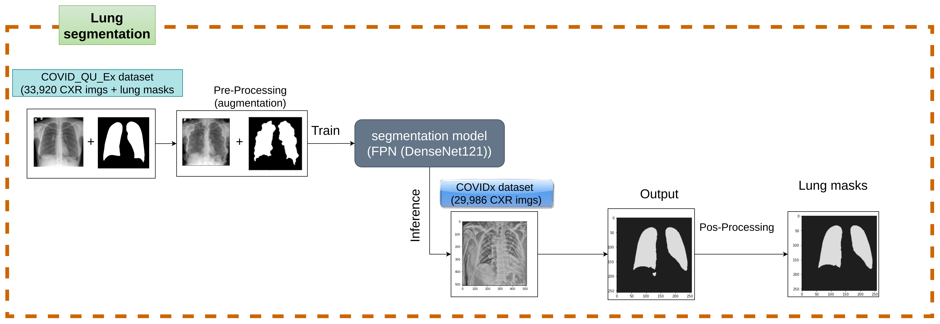
Methods
<number>

Slide 10
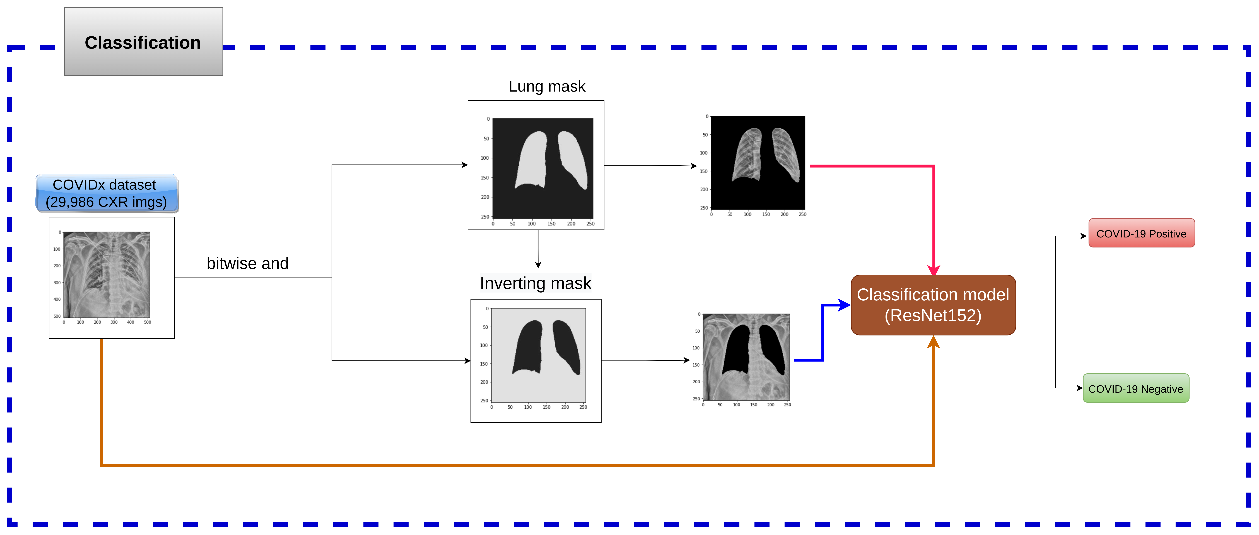
Methods
<number>

Slide 11
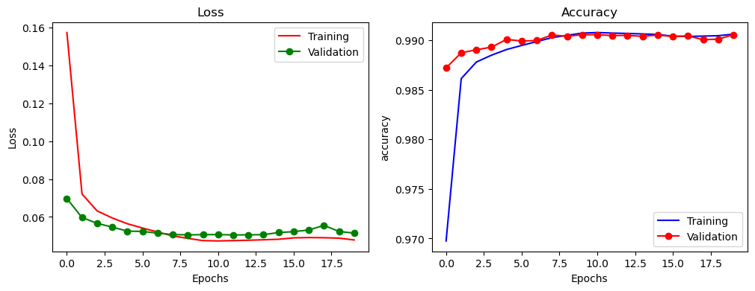
Experimental results (Lung Segmentation)
<number>

Slide 12
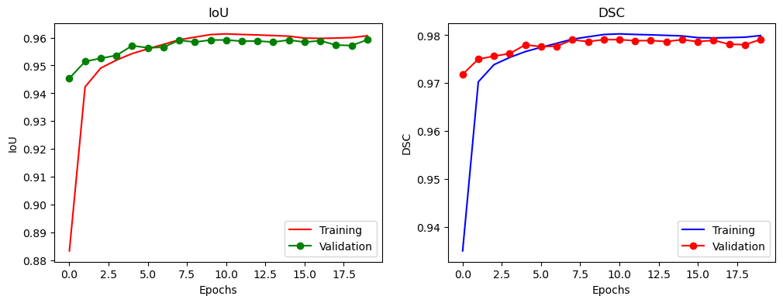
Experimental results (Lung Segmentation)
<number>

Slide 13
Experimental results (Lung Segmentation)
{'jaccard': 0.9579242722194381, 'acc': 0.9902001815222798, 'f1': 0.9784530466544696, 'recall': 0.9713315338024603, 'precision': 0.9857108479841837}
<number>

Slide 14
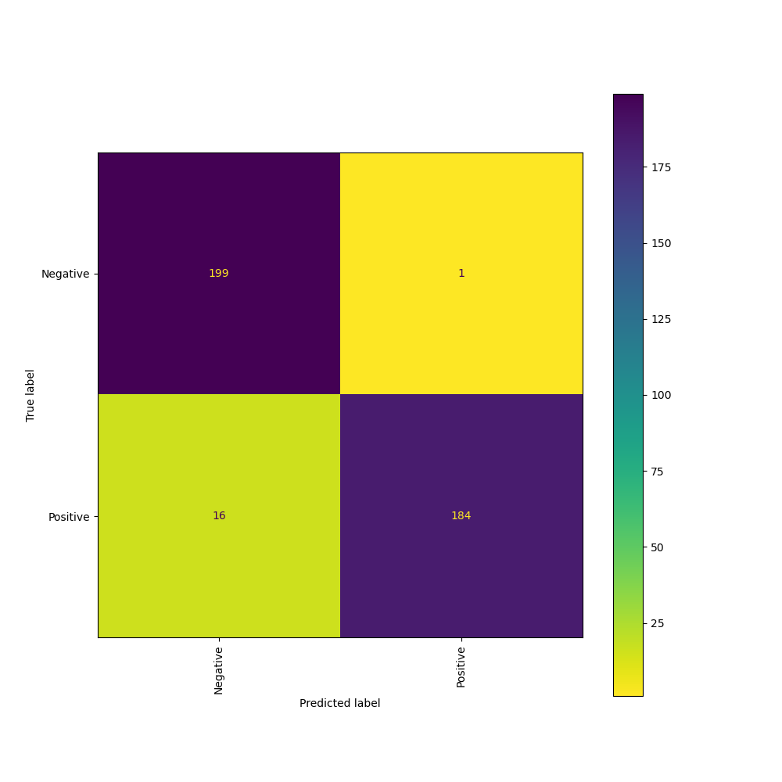
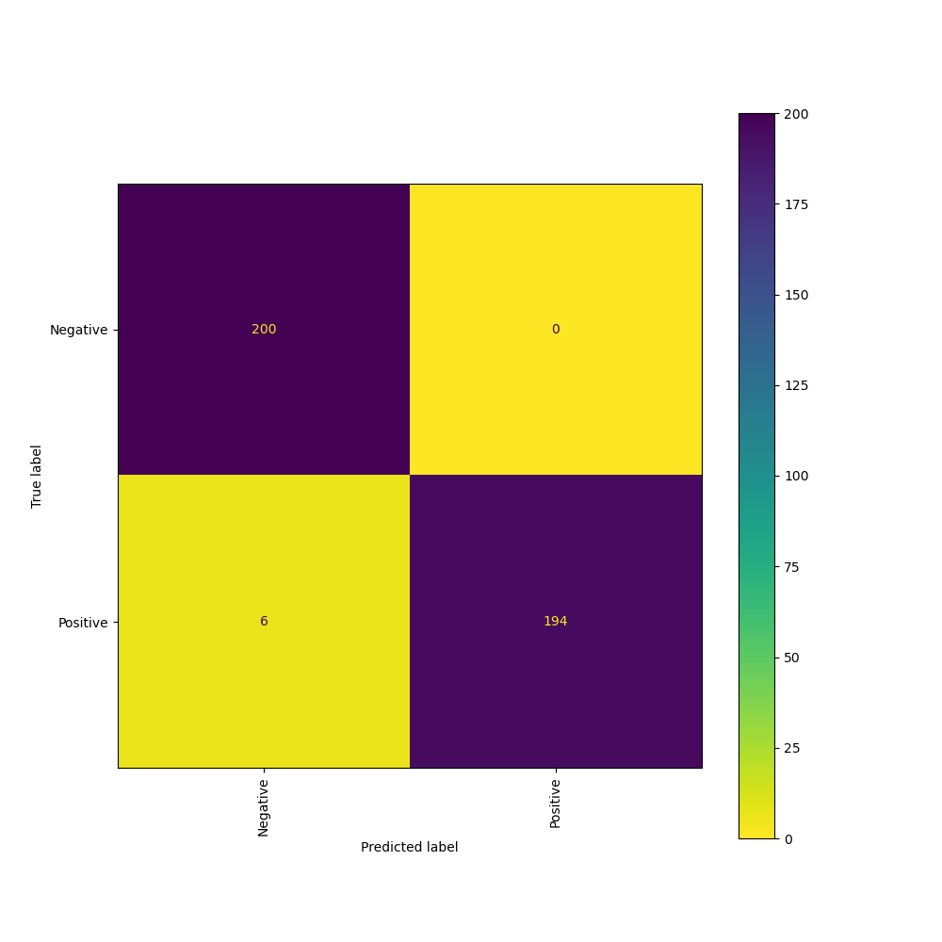
Experimental results (Classification on Grayscale / RGB images)
CXR_GRAYSCALE
CXR_RGB
<number>

Slide 15
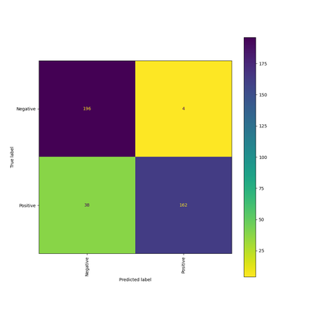
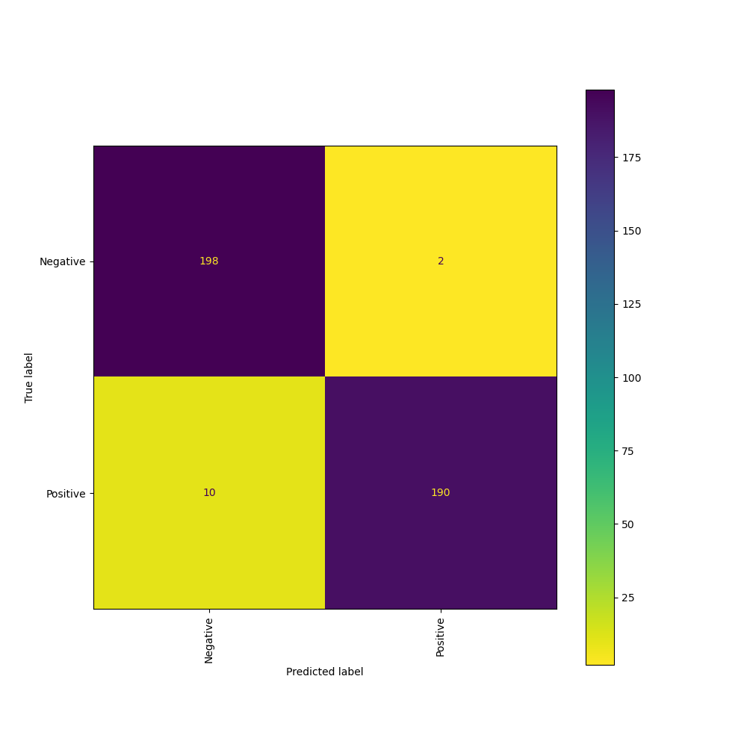
Experimental results (Classification on Grayscale / RGB images)
LUNG_GRAYSCALE
LUNG_RGB
<number>

Slide 16

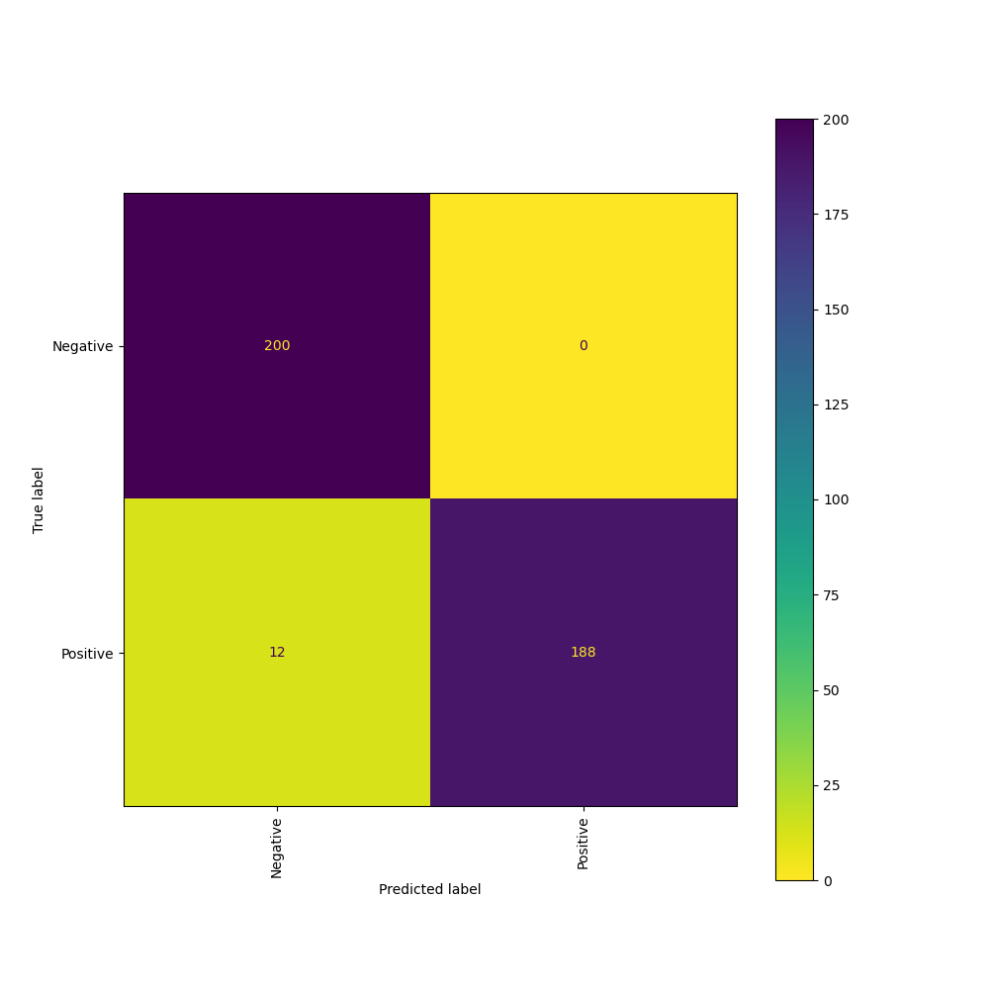
Experimental results (Classification on Grayscale / RGB images)
CXRnotLUNG_GRAYSCALE
CXRnotLUNG_RGB
<number>

Slide 17
Experimental results (Classification on mean/std)

Slide 18
Experimental results (Classification on mean/std)

Slide 19
Experimental results (Classification on CXR / Lung / CXR not Lung images)
<number>

Slide 20
<number>

Slide 21
Conclusions
tạo ra lung mask cho COVIDx CXR3 dataset
Thuc hien classification (Covid-19 Negative/ Positive) treen COVIDx CXR3
Dat duoc hieu suat: ...
<number>

Slide 22


